Slide 1

The Olympic Dream
An Analysis of Olympic Athletes and What Influences Success
Group 9
Kevin Crosby
Kyle Kopacz

Slide 2
Olympic Data Exploration
Which countries have been the most successful at the Olympics?
Who are the most successful Olympians?
When did women’s sports become widespread at the Olympics?
Do rich countries perform better?
Does Geographic location matter to the IOC while determining a host?
Why do countries want to host the Olympics?

Slide 3
Other Questions:
Why does Anthony’s random team generator hate us?

Slide 4
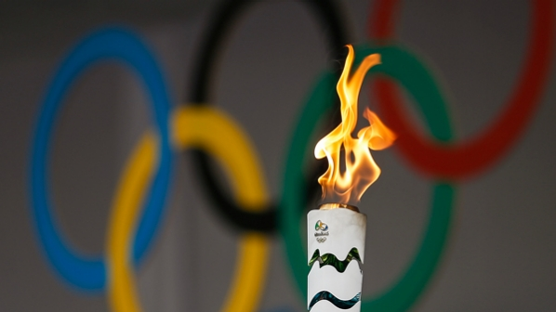
Selecting a Dataset:
We found a record of Olympic Medalists from 1896-2012
Supplemented it with 2012 populations, GDPs, geographic API locations
Broke down into Summer and Winter games
Until 1924, there were no winter games
Both Winter and Summer games were played every 4 years
Simultaneously at separate locations
1994 first year of winter only games
Ever since, they alternate every 2 years

Slide 5
Most Successful Countries
Sample dataset of most awarded countries

Slide 6
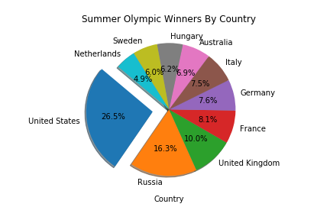
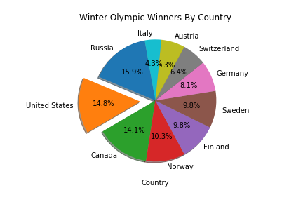
Most Successful Countries: (GS&B)

Slide 7
Most Successful Olympians
Split between Winter and Summer Games

Slide 8
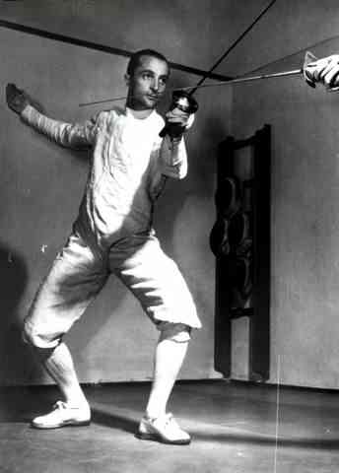
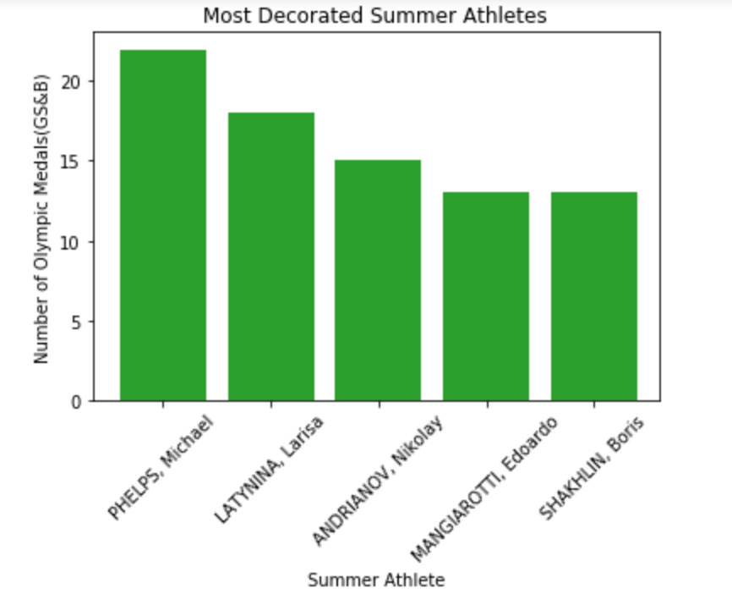
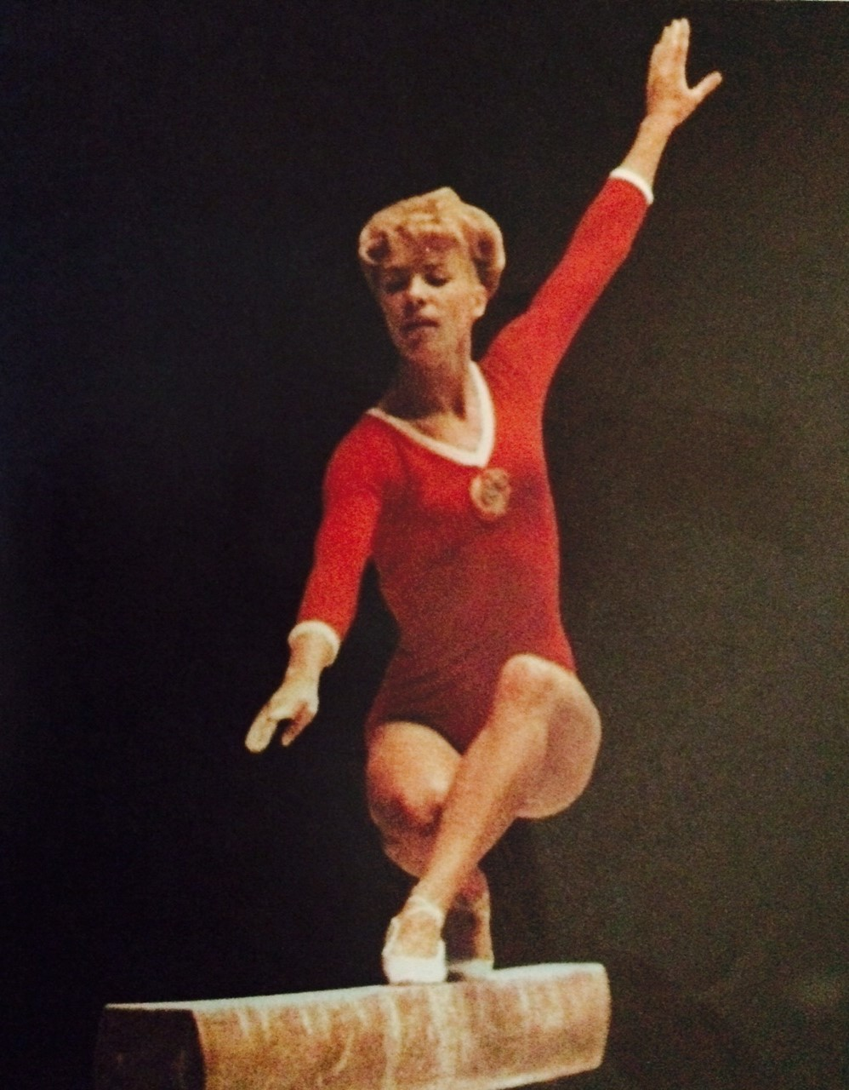
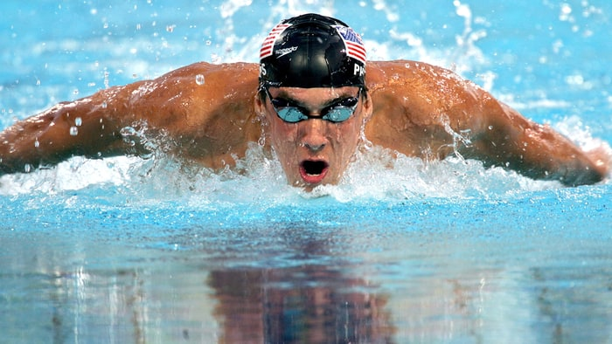
Most Decorated Summer Athlete:

Slide 9
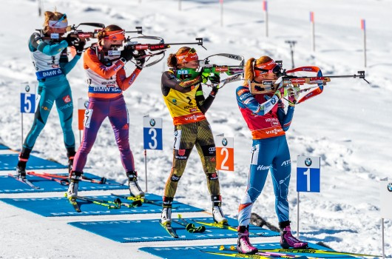
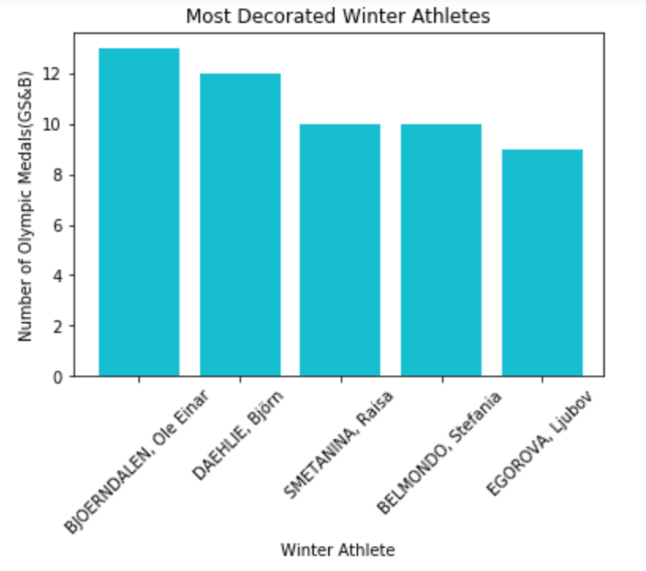

Most Decorated Winter Athlete:

Slide 10
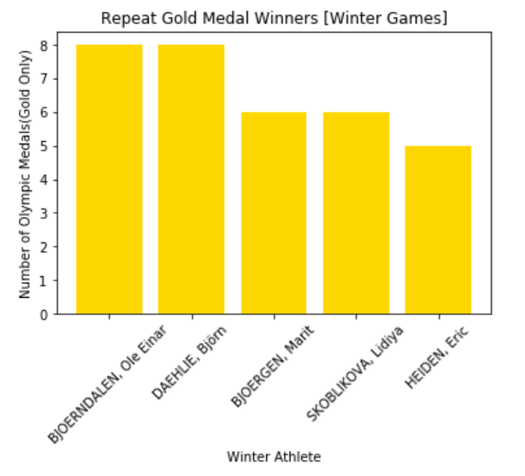
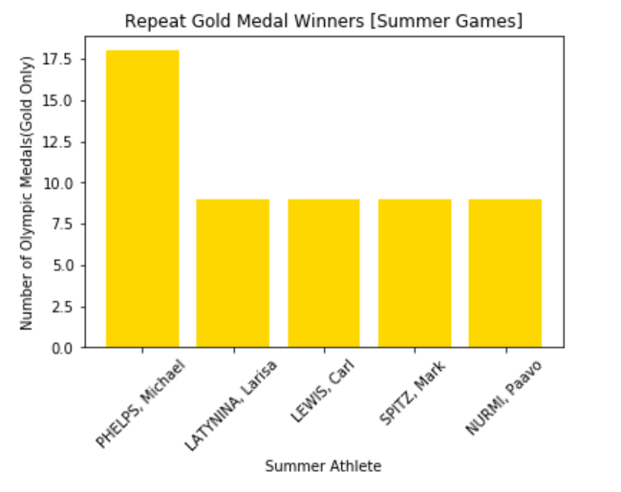
Best Olympians (Gold Only)

Slide 11
Most Successful Olympians
Split between Winter and Summer Games

Slide 12
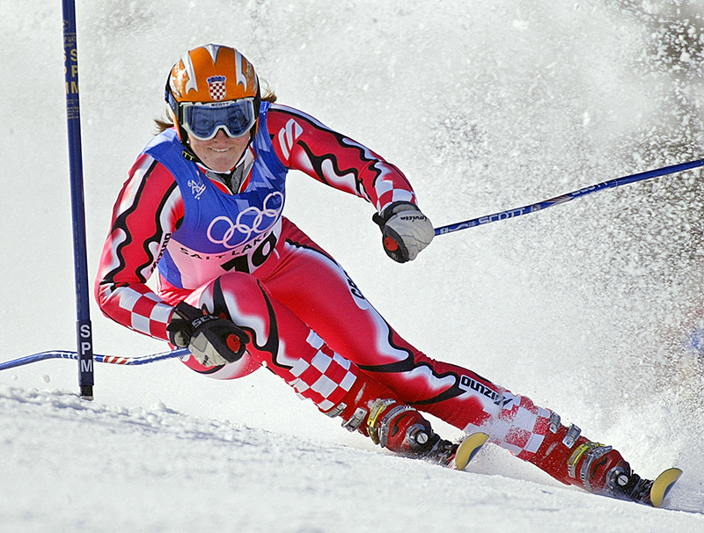
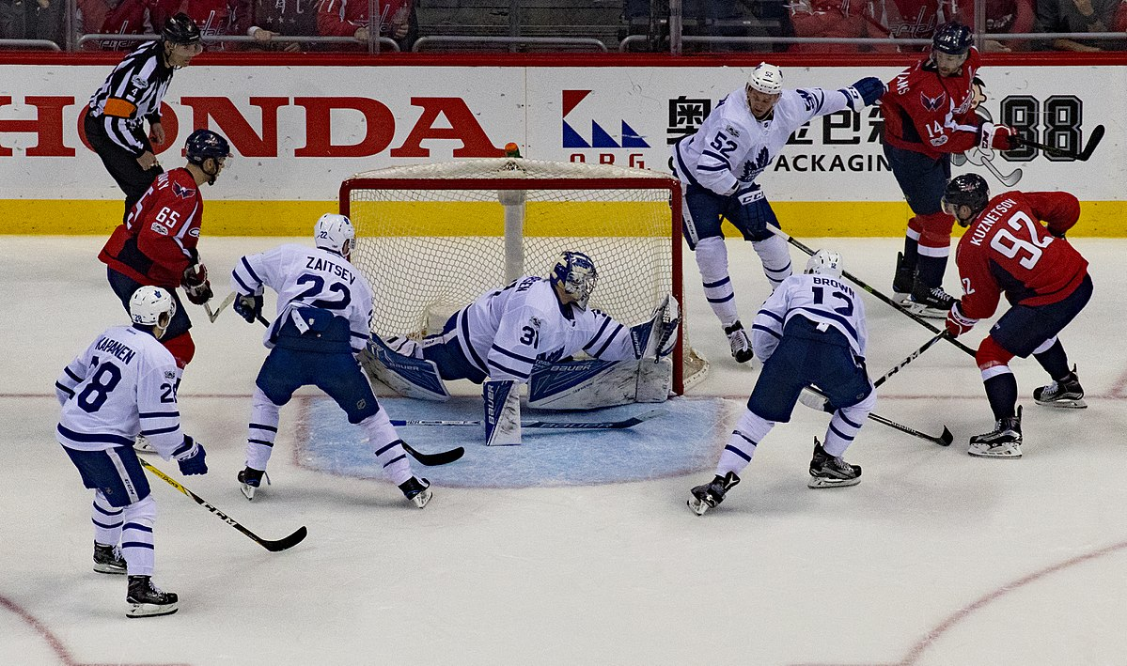
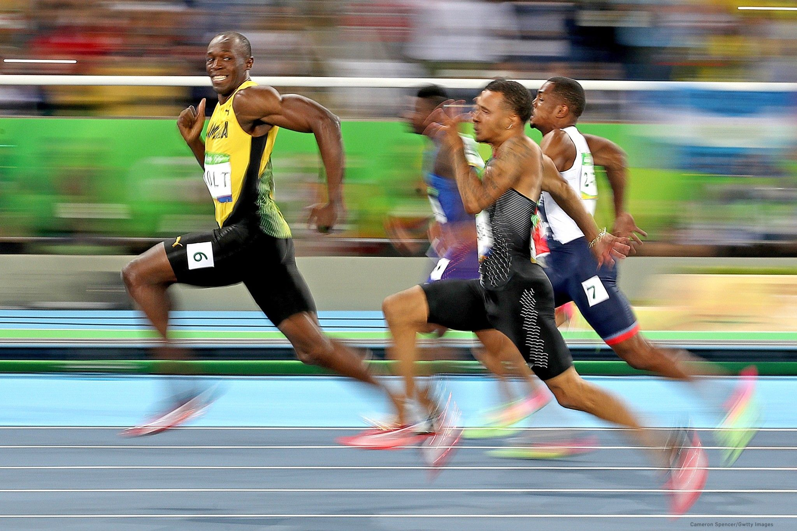
Effect of GDP:
First we had to agree on a metric for wealth, and agreed on GDP per Capita
We expected a linear relationship showing that Per Capita wealth had an effect
Instead, we noticed that wealthy countries performed better during Winter Games

Slide 13
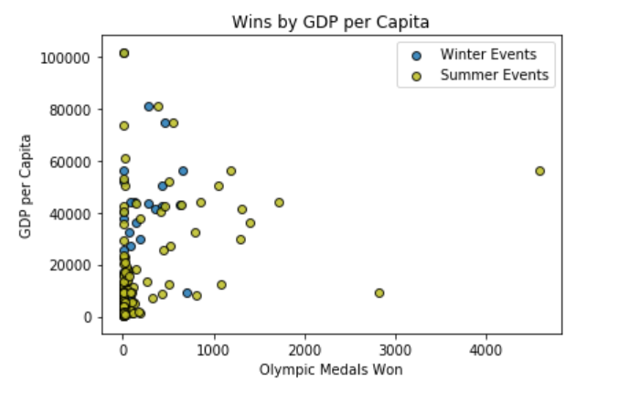
Do Rich Countries Perform Better?

Slide 14
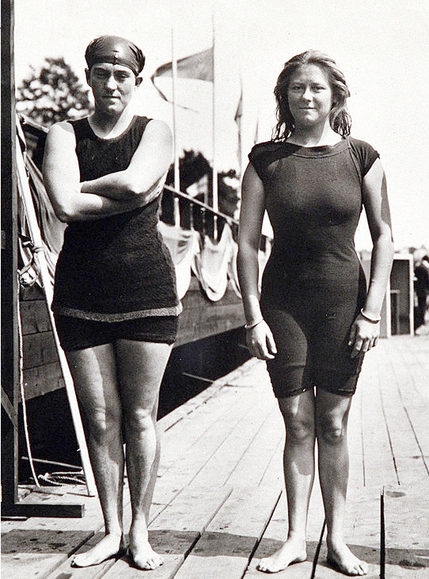
Women’s Sports at the Olympics:
1912 Fanny Durack 100m freestyle swim: First female Olympic Athlete
Over the next few decades, women won various medals in swimming, golf, and archery despite frequently being disqualified from competing
1960 female Olympic competition takes off and most disciplines get a female division

Slide 15
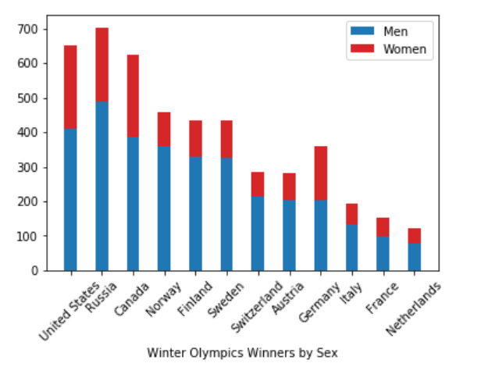
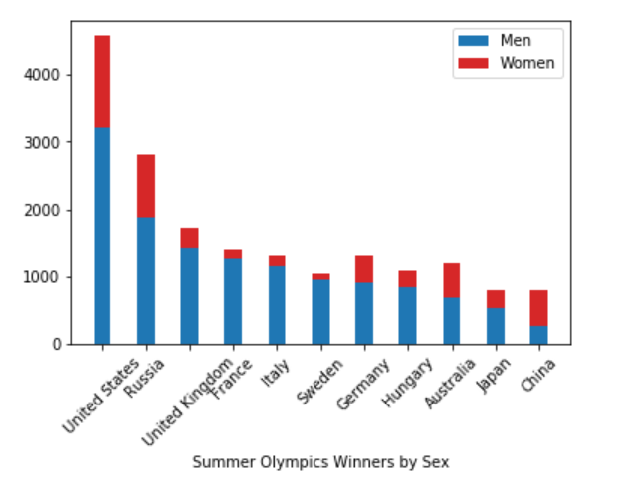
Olympic Medalists by Sex

Slide 16
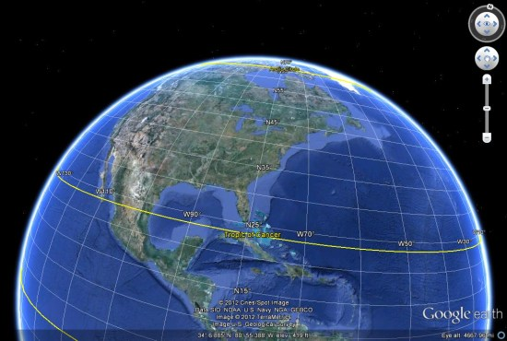
Climate and Geographic Location
The IOC has been found guilty of accepting bribes from countries in bids to host the Olympics.
We wanted to explore geographic patterns between Olympic Hosts:

Slide 17
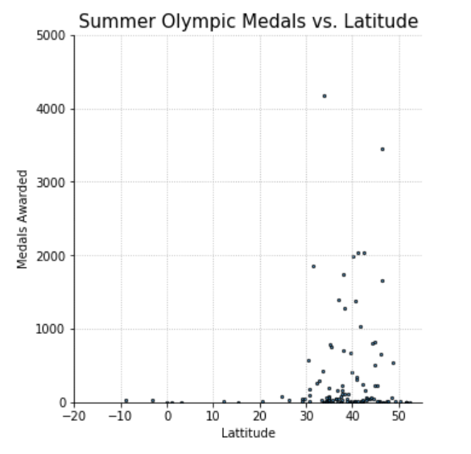
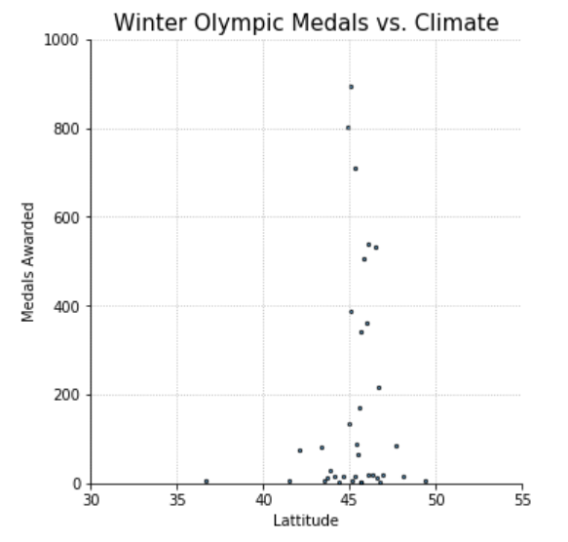
Olympic Host Climate:

Slide 18
Why Do Countries Want to Host the Olympics?
Many counties displace populations and businesses in order to accommodate the Olympic Games
These stadiums and housing structures are often abandoned afterwards
Nearby areas are polluted
Local economies suffer
Yet many governments beg the IOC for the right to host, why?

Slide 19
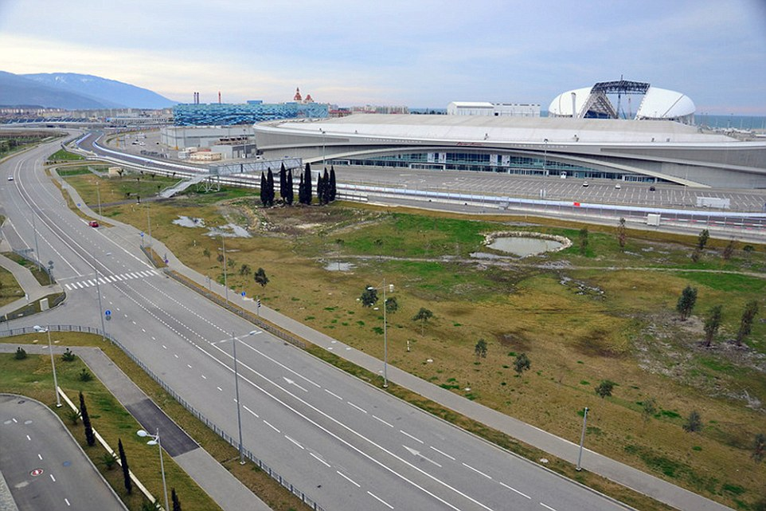
SOCHI ABANDONED:

Slide 20
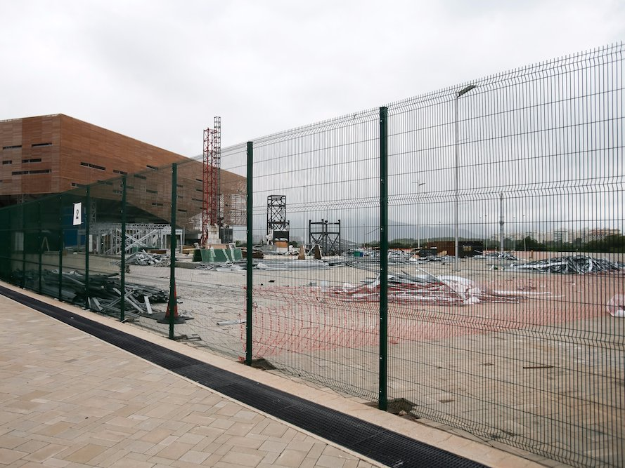
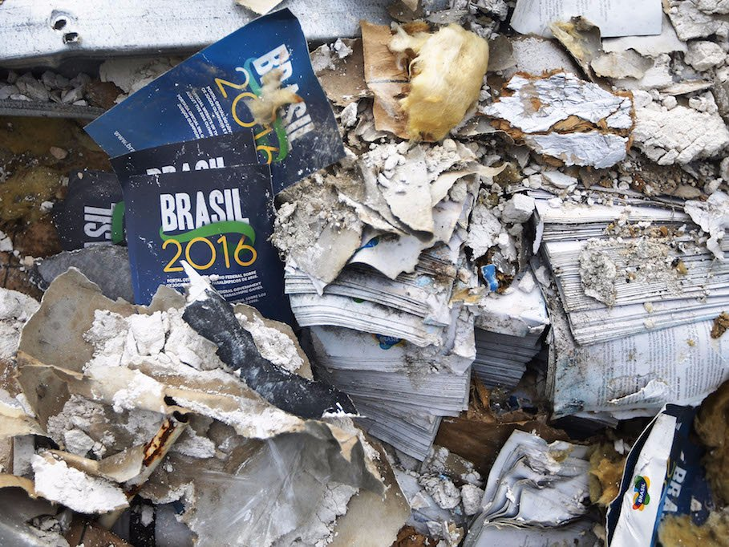
Rio Olympic Park

Slide 21
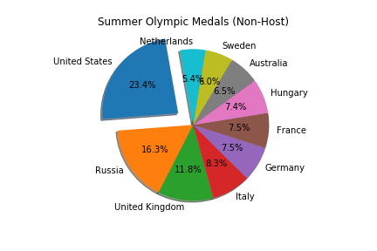
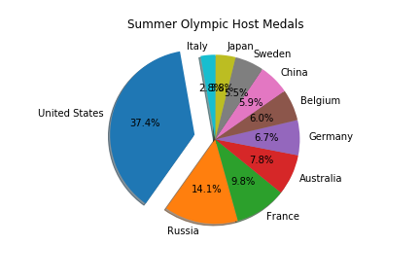
Why Would Anyone Want to Host? (Summer)

Slide 22
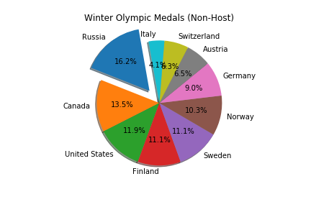
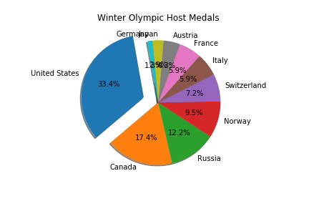
Why Would Anyone Want to Host? (Winter)

Slide 23
Is the Home Team Advantage Real?
Observing the difference in representation, we looked into a few specific cases
When competing in the United States, our win percentage more than doubled
Summer
Home Win: 29.4%
Visiting Win: 14.3%
Winter
Home Win : 63.6% [575/1188]
Visiting Win: 14.1%

Slide 24

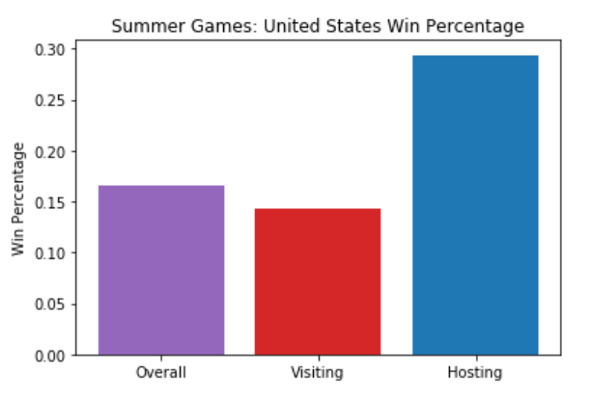
Quantifying Home Team Advantage:

Slide 25
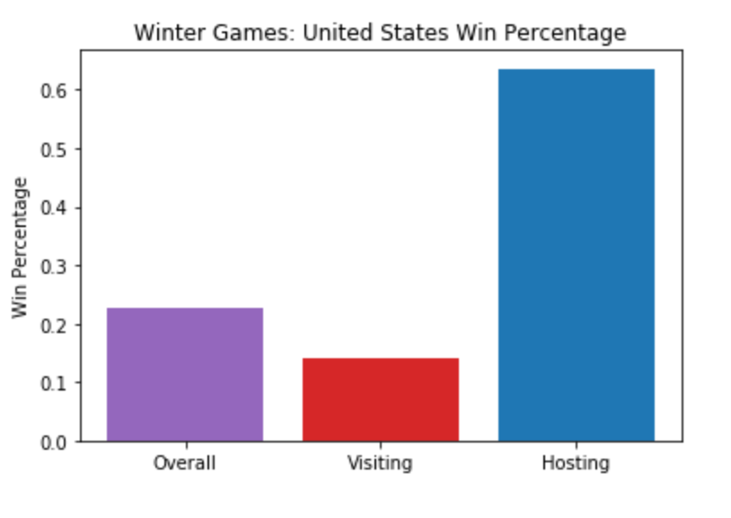
Quantifying Home Team Advantage:

Slide 26
OUR CODE
How did we end up with such great data visualization?

Slide 27

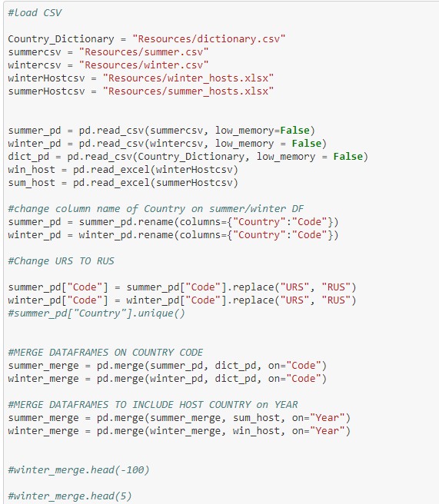
CLEANING DATA

Slide 28
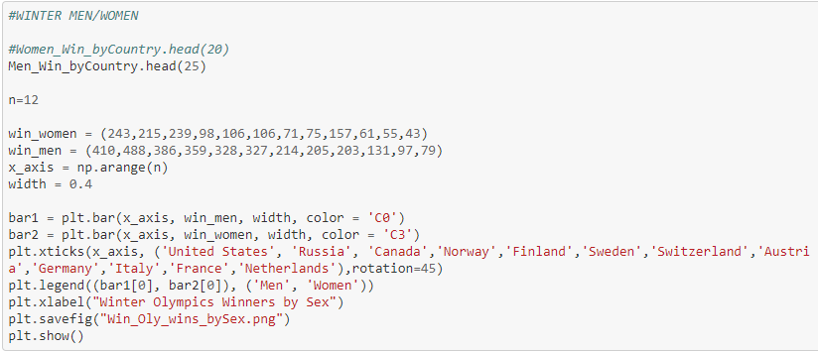
USING MATPLOTLIB (Bar Chart)

Slide 29
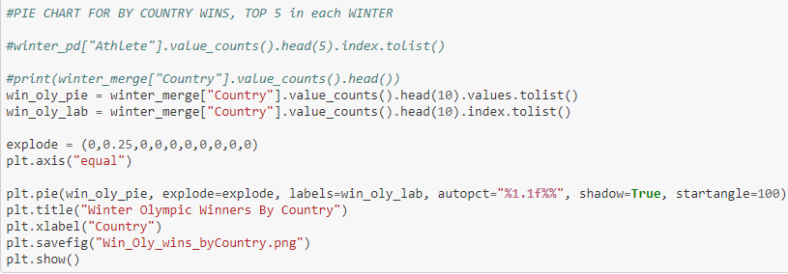
USING MATPLOTLIB (Pie Chart)

Slide 30
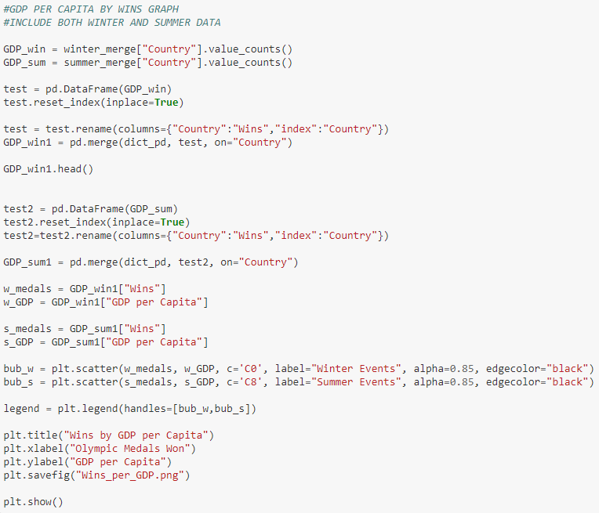
USING MATPLOTLIB (Scatter Plot)

Slide 31
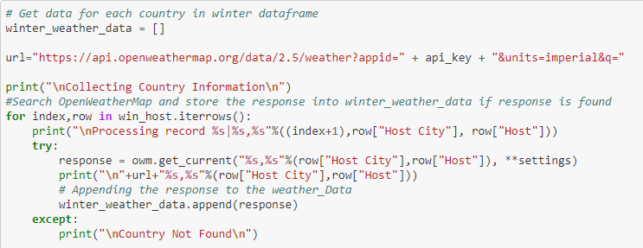
Accessing Open Weather API

Slide 32
Questions?
Feel free to ask to see previous data visualizations

Slide 33
Cited
Sochi: http://www.dailymail.co.uk/news/article-2941216/Extraordinary-images-Vladimir-Putin-s-Sochi-Olympic-park-lying-desolate-abandoned.html
Rio pictures: http://www.businessinsider.com/abandoned-olympic-venues-around-the-world-photos-rio-2016-8/#cleaning-up-guanabara-bay-was-a-big-part-of-rios-successful-bid-to-host-the-games-19
Dataset:
https://www.kaggle.com/the-guardian/olympic-games

